Slide 1
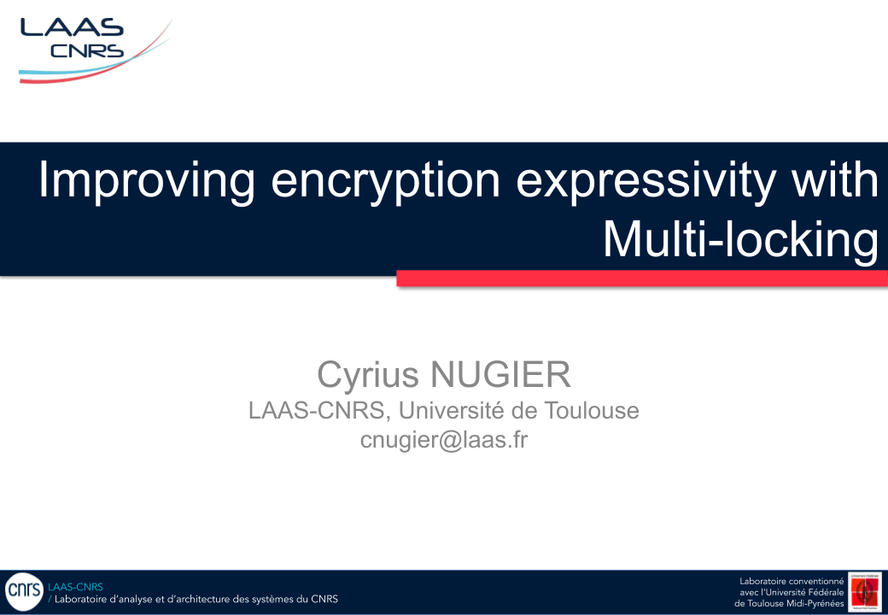

Cyrius NUGIER
LAAS-CNRS, Université de Toulouse
cnugier@laas.fr

Slide 2




Cryptographic Scheme
Plaintext
Ciphertext
Plaintext
Enc
Dec
Encryption
Key
Decryption
Key

Slide 3


Plaintext
Ciphertext
Super-Encryption
Ciphertext
Plaintext
Enc
Dec
Plaintext
Ciphertext
Plaintext
Enc
Dec
Plaintext
Ciphertext
Plaintext
Enc
Dec

Slide 4


Multi-Locking
Dec₁ ∘ Dec₂ ∘ … ∘ Enc₂ ∘ Enc₁ (m)
=
Enc₂ ∘ Dec₂ ∘ … ∘ Enc₁ ∘ Dec₃ (m)
Commutativity

Slide 5








Lock-Key Graph
Charlie
Bob
Daniel
Alice
Eve

Slide 6
Lock-Key Graph
Charlie
Bob
Daniel
Proof 2
Alice
Eve
Sequential Circuit
Proof 1
Alice → ( Bob → Charlie ) OR Daniel → Eve
AND
OR
THEN (→)

Slide 7
Lock-Key Graph
Bob
Charlie
Alice
Daniel
Proof 2
Charlie
Bob
Sequential Circuit
Proof 1
Alice → ( Bob AND Charlie ) → Daniel

Slide 8
Lock-Key Graph
Bob
Alice
Daniel
Eve
Charlie
Proof 2
Sequential Circuit
Proof 1
Alice → ( Bob OR Charlie ) → Daniel → Eve

Slide 9
Lock-Key Graph
Charlie
Bob
Daniel
Proof 2
Alice
Eve
Proof 3
Sequential Circuit
Proof 1
Alice → ( Bob → Charlie ) OR Daniel → Eve

Slide 10
Proof 4
Lock-Key Graph
Construction
Super-Encryption
Multi-Locking
Planar
Non planar

Slide 11
k₁ ⊕ k₂ = k₂ ⊕ k₁
Commutativity
Plaintext
Ciphertext
Plaintext
C = m ⊕ k
m = C ⊕ k
Plaintext
Ciphertext
Plaintext
C = m ⊕ k
m = C ⊕ k
Plaintext
Ciphertext
Plaintext
C = m ⊕ k
m = C ⊕ k
Multi-Locking Family
XOR / One Time Pad

Slide 12
k₁ x k₂⁻¹ = k₂⁻¹ x k₁ [p]
Commutativity
Plaintext
Ciphertext
Plaintext
C = m x k [p]
m = C x k⁻¹ [p]
Plaintext
Plaintext
Ciphertext
Ciphertext
Plaintext
Plaintext
C = m x k [p]
m = C x k⁻¹ [p]
Plaintext
Ciphertext
Plaintext
C = m x e(g,g)^{k} [p]
m = C x e(g,g)^{-k} [p]
Multi-Locking Family
Identity / Attribute
Based Encryption
Modular Multiplication

Slide 13
How to use Multi-Locking
In Practice

Slide 14








Lock-Key Graph
Step 3
Charlie
Bob
Daniel
Step 2
Step 5
Alice
Eve
Step 1
Step 4
Sequential Circuit
Multi-Locking Family
Alice → Bob → Charlie → Daniel → Eve

Slide 15
Cyrius NUGIER
LAAS-CNRS, Université de Toulouse
cnugier@laas.fr

